Slide 1
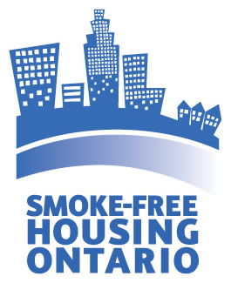
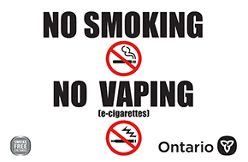
2023
Overview of Smoke-Free Housing in Ontario
Notes:
Rev. 4 December 2023
The intended audience for this powerpoint presentation are landlords and PHUs;
Introduction as per your program’s background;
Promotion of Smoke-Free Housing Ontario website: smokefreehousingon.ca;
Sign link: https://www.ontario.ca/page/no-smoking-no-vaping-signs-businesses

Slide 2
Health Risks due to Second-hand Smoke
There is no risk-free exposure to second-hand smoke (SHS). SHS contains more than 7,000 chemicals, at least 69 of these cause cancer.
Exposure to SHS affects the health of all residents, especially infants, children and pregnant persons, the elderly, and those with pre-existing health conditions like asthma and chronic obstructive pulmonary disease.
Notes:
There is no risk-free exposure to second-hand smoke (SHS): it contains more than 7,000 chemicals, at least 69 of these cause cancer.
Exposure to second-hand smoke affects the health of all residents, especially infants and children, the elderly, and those with pre-existing health conditions like asthma and chronic obstructive pulmonary disease.
In children and infants, second-hand smoke exposure is a cause of respiratory illnesses, low birth weight and sudden infant death syndrome .
Exposure in adults has been linked to cancer, respiratory problems, coronary heart disease and stroke .
Smoke-free housing can help reduce exposure to toxic chemicals and prevent harmful health effects for all residents
Source:
National Cancer Institute: Secondhand Tobacco Smoke (Environmental Tobacco Smoke) - Cancer-Causing Substances - NCI
Health Canada - https://www.canada.ca/en/health-canada/services/smoking-tobacco/avoid-second-hand-smoke/second-hand-smoke/dangers-second-hand-smoke.html
Tobacco Smoke Entering Homes in Multi-Unit Dwellings in Ontario, OTRU, 2014: http://bit.ly/1rEkQAH

Slide 3
Health Risks due to third-hand Smoke
Third-hand smoke (THS) is residual smoke contamination that persists for weeks, months, years
THS settles on surfaces (carpets, curtains, furnishings, walls, ceilings) and in dust and then “off-gases” toxic chemicals that are harmful to human health
This has triggered many hotels and car rental companies to go smoke-free
Consider young children and
pets who touch surfaces often
Notes:
Definition of off-gasses/off-gassing: Off-gassing is the release of a gas that was dissolved, trapped, frozen, or absorbed in some material.
https://no-smoke.org/smokefree-threats/thirdhand-smoke/ -- comprehensive resource for THS
Thirdhand smoke (THS) is a term used to describe the residual contamination from tobacco smoke that lingers in rooms long after smoking stops and remains on our clothes after we leave a smoky place. It may seem merely like an offensive smell, but it is also indicative of the presence of tobacco toxins. Our fact sheet “Thirdhand Smoke in Apartments and Condos” provides more detailed information on the problem.
Thirdhand smoke consists of the tobacco residue from cigarettes, cigars, and other tobacco products that is left behind after smoking and builds up on surfaces and furnishings. Tobacco smoke is composed of numerous types of gasses and particulate matter, including carcinogens and heavy metals, like arsenic, lead, and cyanide. Sticky, highly toxic particulates, like nicotine, can cling to walls and ceilings. Gases can be absorbed into dust in a room, carpets, draperies, and other fabrics or upholsteries. A 2002 study found that these toxic brews can then re-emit back into the air and recombine to form harmful compounds that remain at high levels long after smoking has stopped occurring.

Slide 4
Risks to Pre-Born, Infants & children
During pregnancy, SHS exposure results in a higher risk of still birth and premature birth, low birth weight and babies are at risk of developing health problems in childhood such as leukemia, lymphomas or brain tumors.
Increased risk to babies and children:
Sudden Infant Deaths Syndrome (SIDS)
Respiratory illnesses like asthma, pneumonia, bronchitis
Ear infections
Notes:
Unborn babies are particularly vulnerable to second-hand smoke. Second-hand smoke chemicals can reach them through their mother's placenta.
Second-hand smoke is especially dangerous for babies and children.
Their lungs are still developing and are not as strong as those of adults. Children also breathe more quickly than adults. This causes them to take in more chemicals from the air.
Their immune systems can also be damaged by second-hand smoke toxins.
Source: https://www.canada.ca/en/health-canada/services/smoking-tobacco/health-effects-smoking-second-hand-smoke/dangers-second-hand-smoke.html

Slide 5
Risks to Adults
Second-hand smoke increases the risk of:
heart problems
lung cancer
emphysema
breathing problems including asthma
excessive coughing
nasal and chest infections
Notes:
Even healthy, non-smoking adults are at risk for health problems if they breathe in second-hand smoke. Second-hand smoke increases their risk of respiratory diseases and cancers.
Every year in Canada, second-hand smoke causes 800 deaths from lung cancer and heart disease in non-smokers.
Source: https://www.canada.ca/en/health-canada/services/smoking-tobacco/health-effects-smoking-second-hand-smoke/dangers-second-hand-smoke.html

Slide 6
Smoke-Free Ontario Act, 2017
Smoking or holding lighted tobacco, the use of an e-cigarette, and smoking or holding lighted cannabis (medical or non-medical) is prohibited in enclosed common areas of multi-unit housing such as lobbies, elevators, hallways, laundry rooms, stairwells, exercise facilities, parking garages, etc.
Landlords/property managers must ensure that residents, visitors and contractors are aware of the law by posting signs
Legislated smoke-free/vape-free signs are required by law to be posted to ensure that no one smokes or vapes in these common areas
Signage is available from your local public health unit at no cost
Notes:
See SFOA information below. In addition to the SFOA, 2017, the Province of Ontario has put in place standards, guideline and protocol for smoking, vaping and cannabis.
https://www.health.gov.on.ca/en/pro/programs/publichealth/oph_standards/
https://www.health.gov.on.ca/en/pro/programs/publichealth/oph_standards/docs/protocols_guidelines/Tobacco_Vapour_and_Smoke_Guideline_2021.pdf
https://www.ontario.ca/laws/statute/17s26
https://www.health.gov.on.ca/en/pro/programs/publichealth/oph_standards/docs/protocols_guidelines/tobacco_vapour_and_smoke_protocol_2021.pdf
Social exposure includes visual and sensory cues associated with the use of tobacco, e-cigarettes or related products (e.g., waterpipe). There is evidence that social exposure influences smoking behaviour, including initiation and relapse.
https://www.ontario.ca/page/where-you-cant-smoke-or-vape-Ontario
Multi-unit residences
Common indoor areas
You cannot smoke or vape in any common indoor areas of condos, apartment buildings or college and university residences. Examples of indoor common areas include:
elevators
stairwells
hallways
parking garages
laundry facilities
lobbies
exercise areas
party or entertainment rooms
Second-hand smoke or vapour in rental units
Unless you have signed an agreement or lease or are in a condominium with bylaws that say otherwise, you are allowed to smoke or vape in your private home.
If you live in a building where smoking is allowed, and second-hand smoke or vapour from another unit is interfering with the reasonable enjoyment of your home, speak to your landlord. They may be able to fix the problem with a simple conversation or repair to your unit.
If your landlord does not resolve the issue, contact the Landlord and Tenant Board. You will be asked to show how the other tenant’s smoking or vaping is interfering with your reasonable enjoyment. Each application is determined by the Board on a case-by-case basis.
Landlords
Under the Residential Tenancies Act, 2006 a landlord may apply to evict a tenant if their smoking:
interferes with the reasonable enjoyment of other tenants
seriously impairs safety

Slide 7
Cannabis and the Law
Cannabis became legal for recreational use in Ontario on October 17, 2018. Individuals may use cannabis for medical or recreational purposes.
The Smoke-Free Ontario Act, 2017 regulates the places of use for smoking and vaping cannabis (medical and recreational) similarly to tobacco and vapour products.
The smoke from cannabis is harmful. Toxic and carcinogenic chemicals found in tobacco smoke such as polyaromatic hydrocarbons, aromatic amines, and N-heterocyclics are also found in cannabis smoke.
Notes:
Cannabis became legal for recreational use on October 17, 2018. Individuals may use cannabis for medical or recreational purposes. Medical cannabis is regulated under a separate system than recreational cannabis. The federal government currently regulates access to a legal source of cannabis for medical purposes through the Cannabis Regulations under the Cannabis Act (Canada). Medical cannabis is used for therapeutic purposes.
Medical cannabis can be smoked or vaped, among other methods. Exposure to cannabis smoke and vapour has potentially harmful effects. Cannabis smoke contains levels of chemicals and tar that are similar to tobacco smoke, which can raise the risk of adverse effects on lung health. The effects of second-hand vapour exposure on health remain unknown but could potentially lead to adverse health effects especially in certain populations. The Smoke-Free Ontario Act, 2017 regulates the places of use for smoking and vaping cannabis (medical and recreational).
The smoke from cannabis is harmful. Toxic and carcinogenic chemicals found in tobacco smoke such as polyaromatic hydrocarbons, aromatic amines, and N-heterocyclics are also found in cannabis smoke. https://www.canada.ca/en/health-canada/services/drugs-medication/cannabis/laws-regulations/regulations-support-cannabis-act/health-warning-messages.html

Slide 8
Smoke-free and Vape-Free Homes
Homes that are smoke-free and vape-free are safe and healthy
A no-smoking/vaping policy does not mean a person who smokes or vapes can’t live there, they are legal and non-discriminatory
There is no “right to smoke” enshrined in Canadian law
Notes:
Nicotine addiction can be satisfied in other ways that don’t involve combustible tobacco, cannabis oil added to foods
Resource: https://smokefreehousingon.ca/taking-action/rentals/create-a-no-smoking-policy/

Slide 9
No-Smoking/ vaping Policies are Not Discriminatory
Ontario Human Rights Code
The Code provides protection from discrimination including: citizenship, race, place of origin, ethnic origin, colour, ancestry, disability, age, creed, sex/pregnancy, family status, marital status, sexual orientation, gender identity, gender expression, receipt of public assistance (in housing) and record of offences (in employment).
There is no such thing as a right to smoke; there is a freedom to smoke (or vape) but not a right as preserved in Canadian law, the Charter of Rights and Freedoms or the Ontario Human Rights Code.
Notes:
https://www.ohrc.on.ca/en/ontario-human-rights-code
https://www.toronto.ca/community-people/health-wellness-care/health-programs-advice/live-tobacco-free/second-hand-smoke-and-the-law/smoke-free-apartments-condos-and-co-ops/

Slide 10
Benefits of Having A NO-SMOKING AND NO-VAPE policy
Reduce health harms to all, especially children, those with medical conditions and pets
Decrease landlord costs including turnover expenditures
Lowers risk of fire resulting in lower insurance rates
Provides a healthy environment for tenants
Notes:
Costs -Removing odours, damage caused by smoke, loss of rental income as people want to live in non-smoking units. Landlords report that it typically costs between 2-3 times as much money to turn over a smoking unit compared to a no-smoking unit. Source: Smoke-free Policies Make Good Dollars and Sense: The Business Case for Smoke-free Multi-unit Housing, Non-Smokers’ Rights Association, Smoking and Health Action Foundation, 2008: http://bit.ly/1vM2gdK
Exposure to people smoking and vaping to normalize such behaviours
Lower risk of starting a fire and possible lower insurance rates.
According to the Ontario Office of the Fire Marshal, tobacco materials (cigarettes, cigars and pipes) remain the number 1 ignition source of fatal residential fires .
• From 1998 to 2007, cigarettes were responsible for almost 600 fires per year, and over one quarter (29%) of all fire deaths.

Slide 11
What does it cost to have a tenant who smokes?
Third-hand smoke residue and smells will remain in a home unless professionally removed:
Furniture and textiles must be deodorized. (Fogging or Ozone Treatment >$200)
Ducts must be cleaned. (>$300)
Hard surfaces must be cleaned including hardwood floors. (>$80 per room)
Re-sealing and painting is required. (>$2000 for an apartment)
Carpets need to be professionally cleaned (>$150) or replaced (>$300 per room)
Damage to surfaces including countertops, appliances and built-in furniture
These costs are significantly reduced when turning over a rental unit where the tenant did not smoke.

Slide 12
No-smoking leases and policies are enforceable
Landlords, it is possible to enforce your smoke-free lease!
Smoke-Free Housing Ontario – Taking Action:
https://smokefreehousingon.ca/taking-action/
You can find some ways to take action on second-hand smoke in multi-unit housing
Rentals
Co-ops
Condominiums
Non-Profit Housing

Slide 13
No-smoking leases and policies are enforceable
Enforcing a no-smoking policy for rentals:
Speak with the tenant and review the no-smoking policy and their responsibilities,
Provide a written letter to the tenant indicating the details of the violation and any discussions you have had with the tenant on the subject,
Document all violations and witnesses to the violations,
Write a warning letter before serving the tenant a Notice to Terminate a Tenancy Early N5 form
Complete a ‘Notice to Terminate a Tenancy Early’ form that serves as an eviction warning
Conduct regular inspections with proper notice, and
Actively address complaints.
For more information about enforcement for rentals (and other multi-unit housing):
https://smokefreehousingon.ca/taking-action/rentals/enforcing-a-no-smoking-policy/
Notes:
https://smokefreehousingon.ca/taking-action/rentals/
https://smokefreehousingon.ca/taking-action/rentals/enforcing-a-no-smoking-policy/

Slide 14
NO-SMOKING policies
Do NOT prohibit smokers from renting/occupying accommodations
Do NOT evict current tenants who smoke
Do NOT force tenants/members to quit smoking
Do NOT force housing providers to provide non-smoking accommodations

Slide 15
What is legal?
No-smoking policy legal opinions
“Landlords have the right to impose additional obligations or restrictions on tenants beyond the standard lease agreement, as long as these requirements do not conflict with the RTA, Code or any other federal law.”
Landlord and Tenant Board decisions continue to confirm legality of no-smoking policies

Slide 16
SMOKE-FREE HOUSING Resources and Supports
Notes:
For presenter to share local, regional and other community resources in addition to below resources identified. May be subject to change from 2024 and onwards.
Smoke and vape free policies are legal and in demand
According to the SFOA, 2017, Cannabis use and vaping are illegal in all places where smoking tobacco is banned
Resources:
https://smokefreehousingon.ca/wp-content/uploads/2015/12/kandlord-guide-aug-2010.pdf
https://www.toronto.ca/community-people/health-wellness-care/health-programs-advice/live-tobacco-free/second-hand-smoke-and-the-law/smoke-free-apartments-condos-and-co-ops/
https://housingrightscanada.com/resources/ontario-housing-law-basics-smoking/
https://landlordselfhelp.com/human-rights-no-smoking-policies-multi-unit-dwellings/
https://www.canada.ca/en/health-canada/services/publications/healthy-living/make-your-home-smoke-free-multi-unit-residence.html

Slide 17
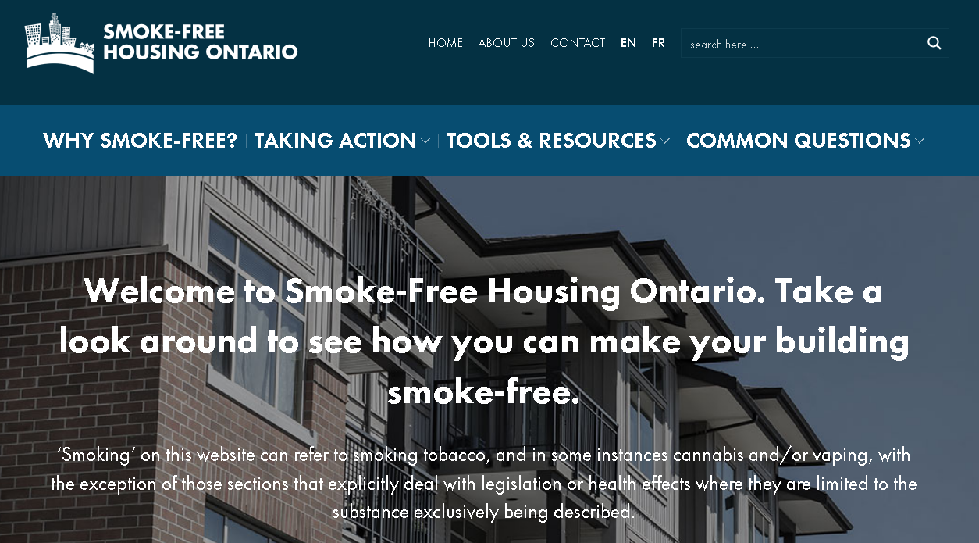
Smoke-Free Housing Ontario
Notes:
One of the initial supports developed (by the Non-Smokers’ Rights Association) to support education for rental, condo, co-op and non-profit housing owners, property managers and tenants was the Smoke-Free Housing Ontario website. This website is up to date and has been tremendously helpful to me when I’m on the phone with tenants or landlords asking very specific information about Human Rights or what they can legally do.
Go through website – Steps to take for rental, condo, co-op, non-profit in terms of first steps like talking to neighbour, documentation of problem, to drafting and enforcing a policy. It also contains lots of tools such as tenant surveys, sample policies, communications, signs, etc. There is a section for public health staff with a quick reference guide to handling smoke free housing inquiries, etc. And then a common questions section.

Slide 18
Local resources
For PHU to insert local Smoke-Free/Vape-Free campaigns including for smoke-free housing. Otherwise delete.
Notes:
Consider linking to: https://www.toronto.ca/community-people/health-wellness-care/health-programs-advice/live-tobacco-free/second-hand-smoke-and-the-law/smoke-free-apartments-condos-and-co-ops/

Slide 19
Next Steps and Recommendations
Refer to your local health unit for more information:
https://www.ontario.ca/page/public-health-unit-locations
Smoke-Free Housing Ontario website:
https://smokefreehousingon.ca/
Landlord and Tenant Board:
https://tribunalsontario.ca/ltb/
Notes:
Adjust as needed depending on PHU-specific resources and recommendations.

